Slide 1
HeART of WORSHIP

Slide 2
Worship is not just about what we do, its also about what we think and say
Write down:
What is God telling me through this verse?
What does this verse tell me about God?

Slide 3
In even the simplest thing,
we do it as for God, and not for people.
That’s worship.
Use art materials:
Add color and design to the verse, according to your creativity

Slide 4
RECAP (Exodus 32:1-35)

Slide 5
BIG IDEA
While Moses was away, Israel made a statue (‘golden calf’) of what they thought God was like. This angered God, but Moses asked Him not to destroy them.
It is dangerous to create something to represent what God is like. Instead, we learn from Jesus exactly what God is like and trust Him.

Slide 6
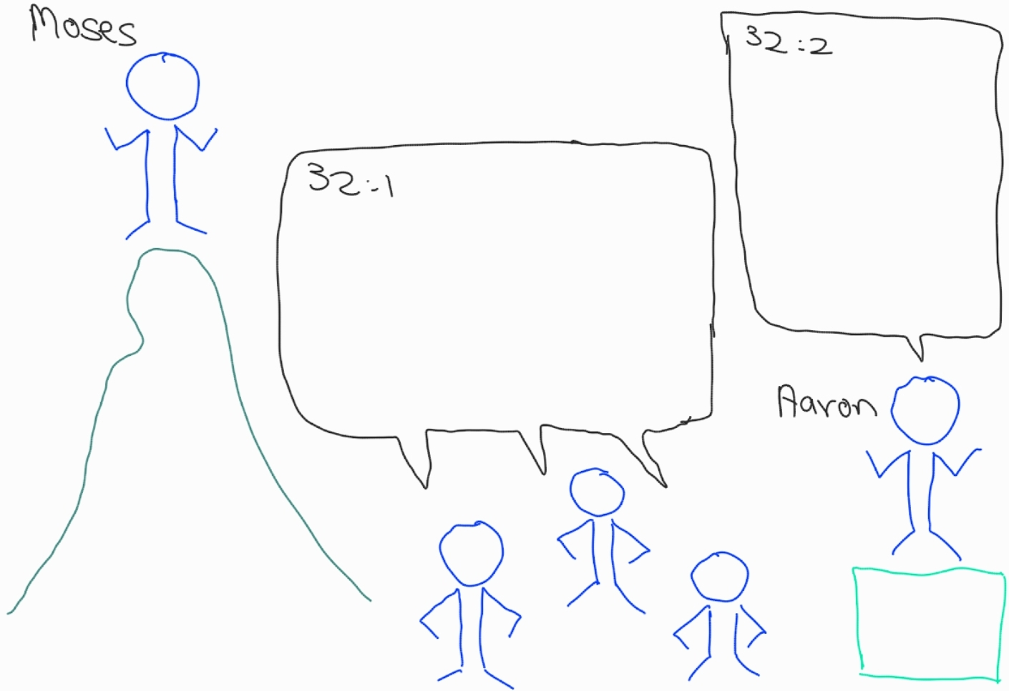
“Give me your gold jewelry”
“Give us a god whom we can see
As for Moses, we don’t know what has happened to him”

Slide 7
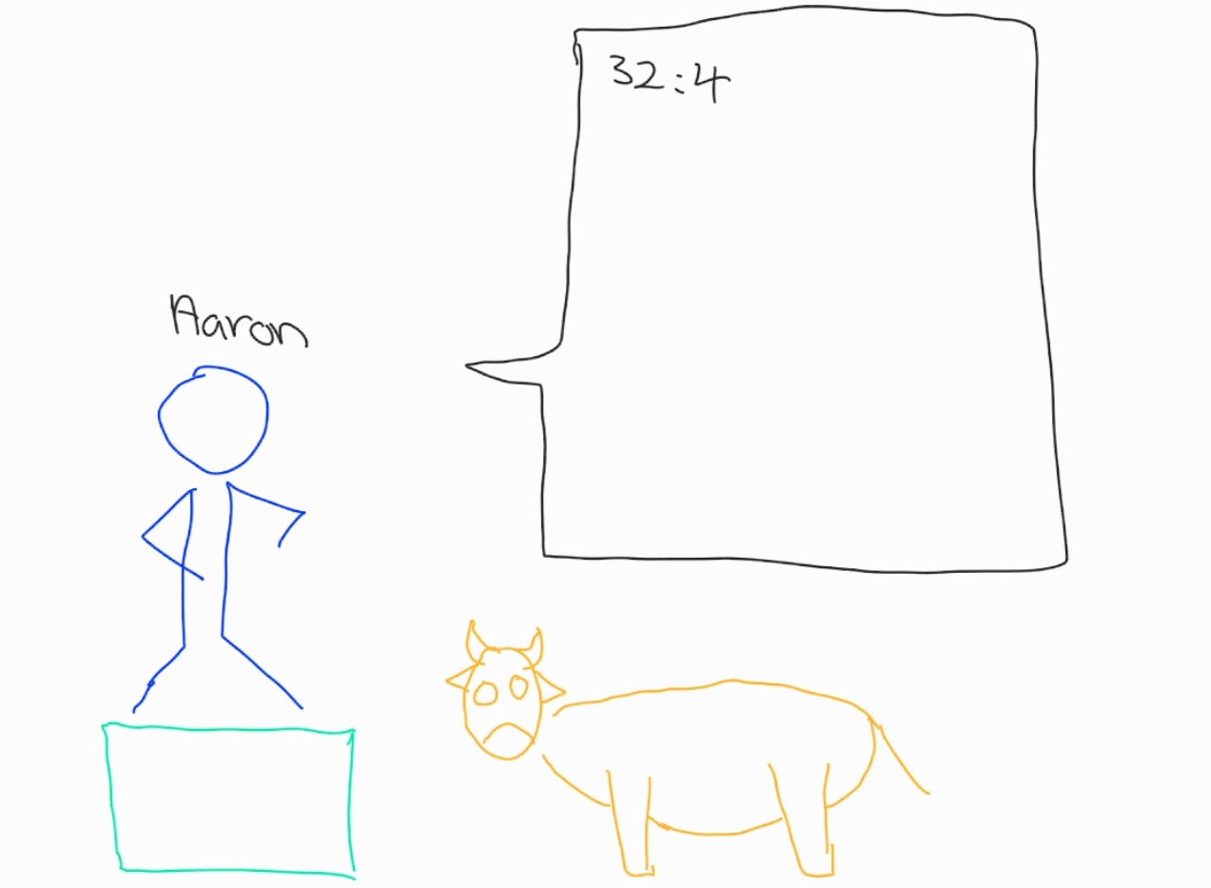
“I have created a golden calf. This is your god, worship and bring your offerings”

Slide 8
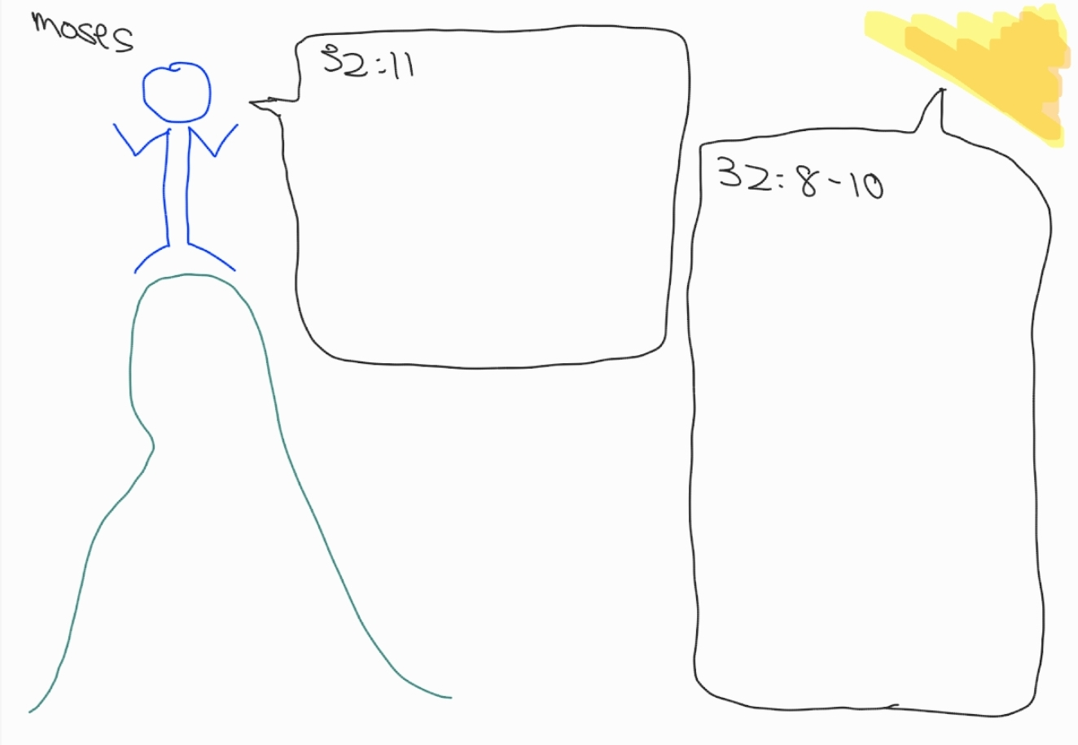
“My Lord, why do you want to destroy the people whom you brought out of Egypt with your mighty power”
“Your people have created a golden calf to worship and brought sacrifices. They are a stiff-necked people. Let my wrath burn against them”

Slide 9
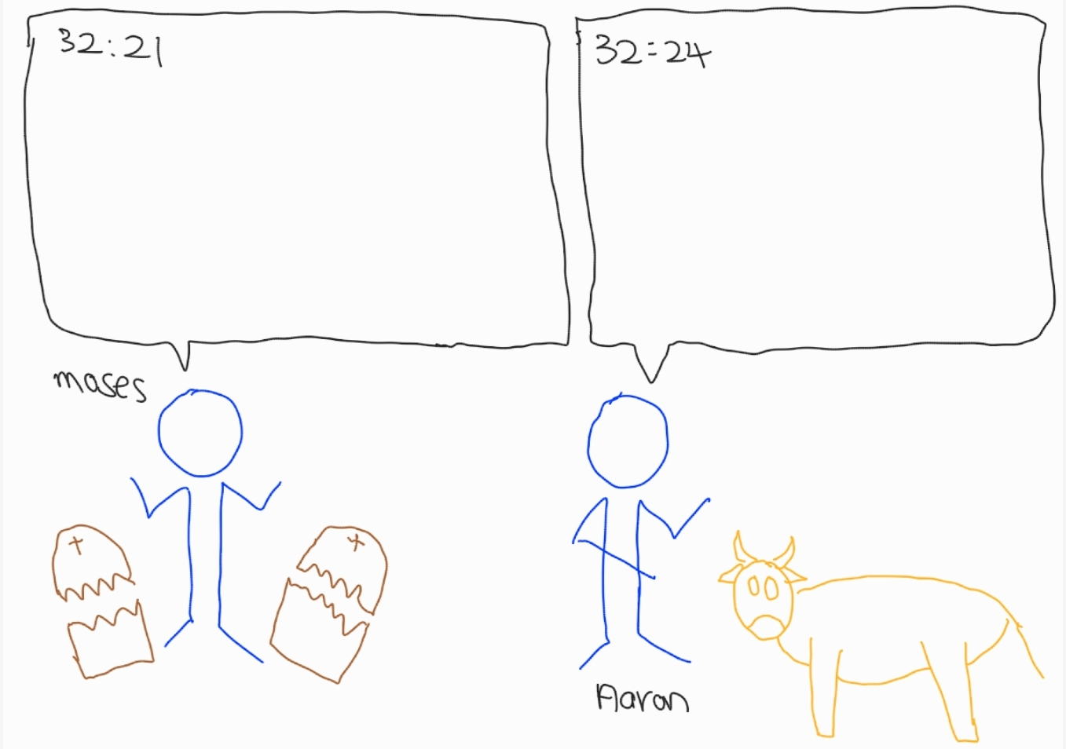
“Aaron, what did the people do to you that you have made such a thing and brought such a sin to them?”
“I cast the gold jewelry into fire, and out came this thing!”

Slide 10
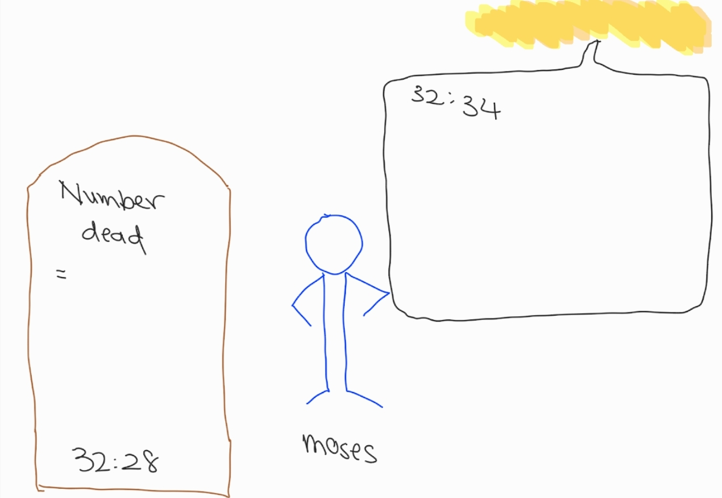
“Now, lead the people into the land which I have spoken to you. My Angel will go before you”
3000

Slide 11



Slide 12
LAST WEEK’S BIG IDEA
While Moses was away, Israel made a statue (‘golden calf’) of what they thought God was like. This angered God, but Moses asked him not to destroy them.
It is dangerous to create something to represent what God is like. Instead, we learn from Jesus exactly what God is like and trust him.
BUT WAS GOD STILL ANGRY WITH THEM?

Slide 13
SECOND CHANCES

Slide 14
Second Chances
Have you ever wronged a friend and they refused to talk to you? Or have you ever tried to ghost a friend who wronged you?
How did you/they get a message to you/them to say sorry?
How badly did you/they want a second chance?

Slide 15
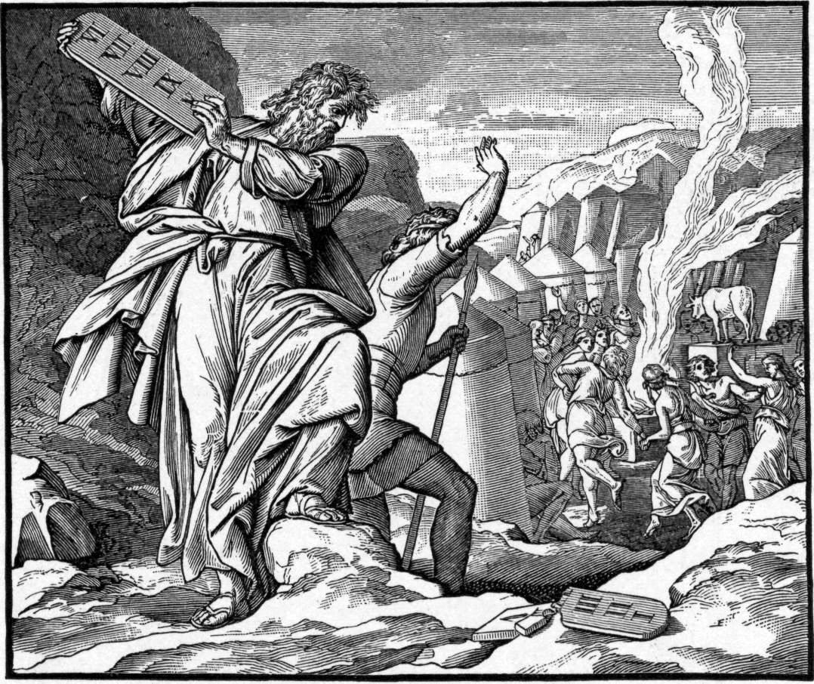
What was broken?
What was broken to show that the covenant between The Lord and Israel had been broken?

Slide 16
How did Yahweh feel about Israel?
Exodus 33:1Then the Lord said to Moses, “Leave this place, you and the people you brought up out of Egypt, and go up to the land I promised on oath to Abraham, Isaac and Jacob, saying, ‘I will give it to your descendants.’ 2 I will send an angel before you and drive out the Canaanites, Amorites, Hittites, Perizzites, Hivites and Jebusites. 3Go up to the land flowing with milk and honey. But I will not go with you, because you are a stiff-necked people and I might destroy you on the way.”
Was it fair for God to be angry with the Israelites for creating and worshipping the golden calf with a drunken party?
In v2, what did God want to do with the Israelites?
How would you feel if God was angry with you and refused to go with you?

Slide 17
Why did Yahweh accept Moses’ plea?
Exodus 33:15Then Moses said to him, “If your Presence does not go with us, do not send us up from here. 16How will anyone know that you are pleased with me and with your people unless you go with us? What else will distinguish me and your people from all the other people on the face of the earth?”
17And the Lord said to Moses, “I will do the very thing you have asked, because I am pleased with you and I know you by name.”
What reason did God say that he accepted Moses’ plea?
Do you wish you had a Moses to plead for you each time you sinned?

Slide 18
A Second Chance!
Exodus 34:1 The Lord said to Moses, “Chisel out two stone tablets like the first ones, and I will write on them the words that were on the first tablets, which you broke. 2Be ready in the morning, and then come up on Mount Sinai. Present yourself to me there on top of the mountain. 3No one is to come with you or be seen anywhere on the mountain; not even the flocks and herds may graze in front of the mountain.”
What was a sign that God was giving Israel a second chance?

Slide 19
GAME!

Slide 20
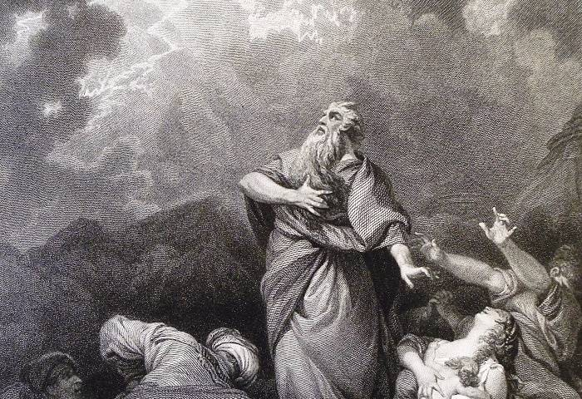
Israel needed someone to plead for them to God
Moses said, please forgive them, or take my life in exchange!

Slide 21
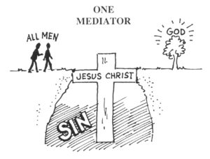
Israel needed someone to plead for them to God
Moses said, please forgive them, or take my life in exchange!
Jesus says, “my death paid for your sins so you can be friends again with God!”

Slide 22
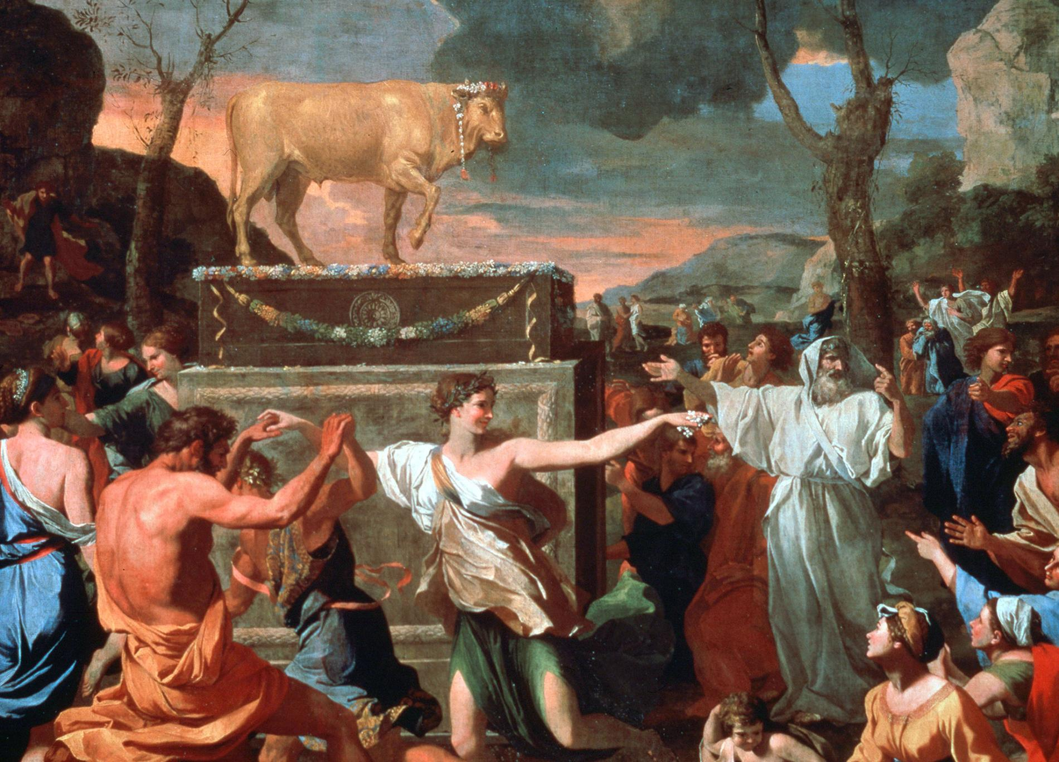
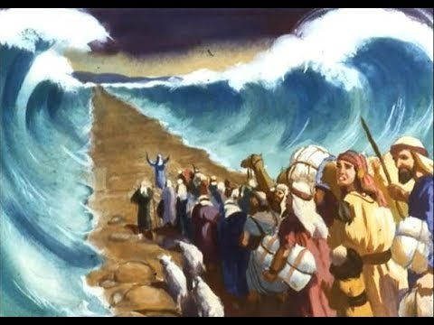
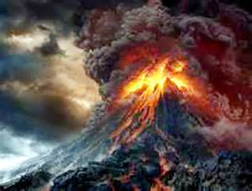
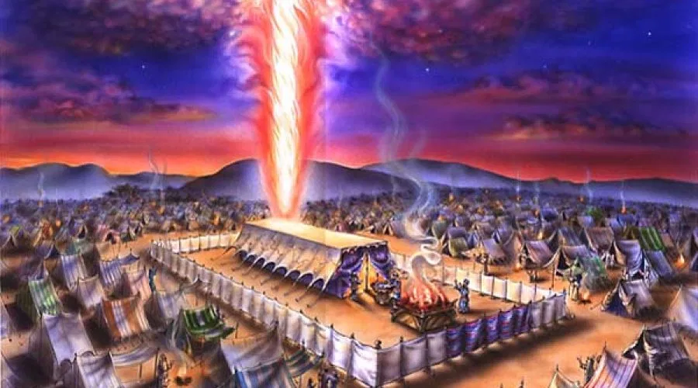
God loves Israel and displays his love in real action
Israel rebelled against God despite God telling them not to make images of God
God’s anger and refusal to go with them
(they were destroying themselves by rebelling against God’s kindness)
God chooses Moses to plead for Israel
God’s relationship to Israel is restored

Slide 23
God loves Israel and displays his love in real action
Israel rebelled against God despite God telling them not to make images of God
God’s anger and refusal to go with them
(they were destroying themselves by rebelling against God’s kindness)
God chooses Moses to plead for Israel
God’s relationship to Israel is restored
God loves you and wants you to love him too
We rebel against God and go our own way as enemies of God (sin)
God needs to punish our sin by condemning us to death
God chooses Jesus to plead for us
God’s relationship to us is restored (if you turn away from sin and follow Jesus)

Slide 24
Do this quiz on your own pieces of paper
What evil thing did Israel do that God was so angry with?
What commandment did Israel break?
What two things did God want to do to Israel as a result of their sin?
What two things did Moses do to change God’s mind?
Even after he said he wouldn’t destroy Israel, why didn’t God want to go with Israel to the Promised Land?
Even though the Promised Land had a lot of resources, what would the Promised Land be like without God?
What made God agree to go with Israel?
How is Jesus similar to Moses?
How is Jesus different to Moses?
Notes:
Golden calf
1 and 2. You shall have no other gods before me. You shall not make any image and worship it.
Wipe out Israel and restart again with Moses.
Moses pleaded with God and offered himself in exchange for Israel
God might destroy Israel because they were so sinful.
Empty, nothing special, not worth it.
Moses pleaded with God based on Moses’ favour with God

Slide 26
Answers
Golden calf
1 and 2. You shall have no other gods before me. You shall not make any image and worship it.
Wipe out Israel and restart again with Moses.
Moses pleaded with God and offered himself in exchange for Israel
God might destroy Israel because they were so sinful.
Empty, nothing special, not worth it.
Moses pleaded with God based on Moses’ favour with God
Jesus pleads for us like Moses pleaded for Israel’s life; God chose Jesus and Moses to plead.
Jesus is God, Jesus sacrificed his life for our lives but Moses didn’t die for Israel.
What evil thing did Israel do that God was so angry with?
What commandment did Israel break?
What two things did God want to do to Israel as a result of their sin?
What two things did Moses do to change God’s mind?
Even after he said he wouldn’t destroy Israel, why didn’t God want to go with Israel to the Promised Land?
Even though the Promised Land had a lot of resources, what would the Promised Land be like without God?
What made God agree to go with Israel?
How is Jesus similar to Moses?
How is Jesus different to Moses?

Slide 27
Format
11:00 Art worship
11:10 Recap
11:20 Lesson A
11:35 Torch Game
11:45 Toilet Break
11:55 Lesson B + Quiz
12:10 Summary
12:15 Polar Bear

